Slide 1
REPORT ON MEDICAL RECORDS
Shaily Antala
20220701037

Slide 2
INDEX
Introduction
Aim of the project
Intended outcome of the project
Dataset
Data description
Proposed methods
Statistical analysis
Statistical visualization
Deep learning algorithms

Slide 3
INTRODUCTIOn
Medical Analytics in the realm of Healthcare plays a vital role in understanding the intricacies of the patient well-being as well as the efficiency of the healthcare systems.
By taking various attributes to consider for the analysis the sector can proliferate.
In this comprehensive we look at diverse patient profiles, each representing some unique set of medical conditions and included treatment plans.
A well-organized medical health report is an essential tool for healthcare providers, offering a path for efficient coordination and communication between the different medical specialists involved in a patient's care.
It documents the patient's whole medical experience and is an invaluable tool for analysis and future reference.

Slide 4
AIM OF THE PROJECT
It aims to gather insights regarding varying patterns and respective trends, correlations within the dataset, resources utilized, with an overall intervention of results.
Utilizing cutting-edge statistical and data analysis methods to extract valuable insights from patient health data is the main goal of creating a medical health report in R.
R is an effective statistical computer language that helps medical practitioners easily organize, analyze, and visualize a variety of medical data.

Slide 5
INTENDED OUTCOME OF THE PROJECT
The medical health report intends the following outcomes :
Understanding the incidence of a disease by observing its contributing demographic factors.
Assessing medical treatments and intervention of patient to identify factors influencing recovery.
Evaluation of cost to improve with cost-effectiveness as a healthcare strategy.
Data driven decision making.
Predictive model to analyze progression, and complications.

Slide 6
DATASET
CODE

Slide 7
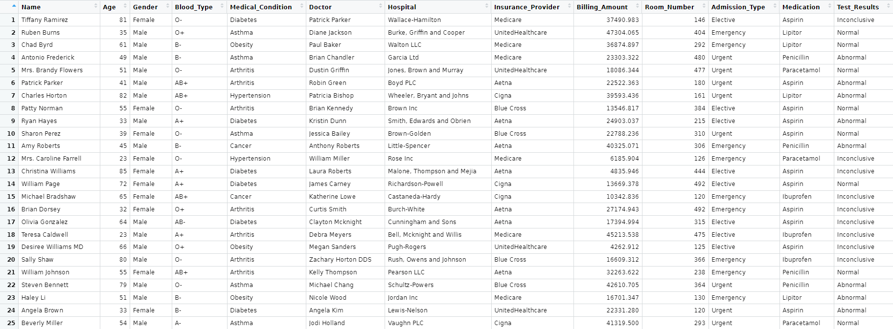

Slide 8
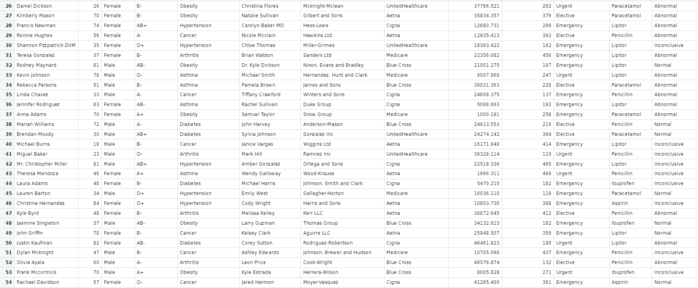

Slide 9
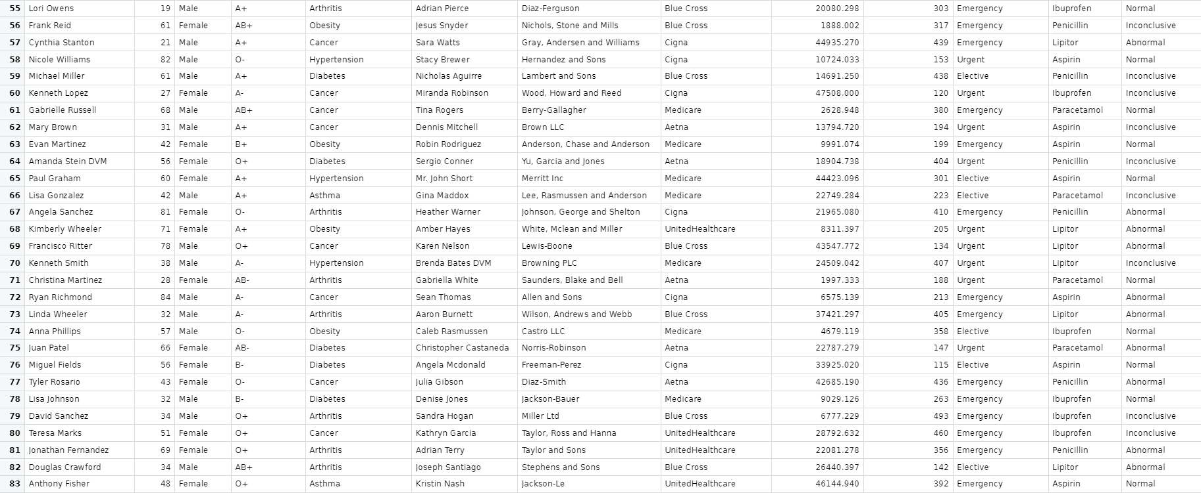

Slide 10
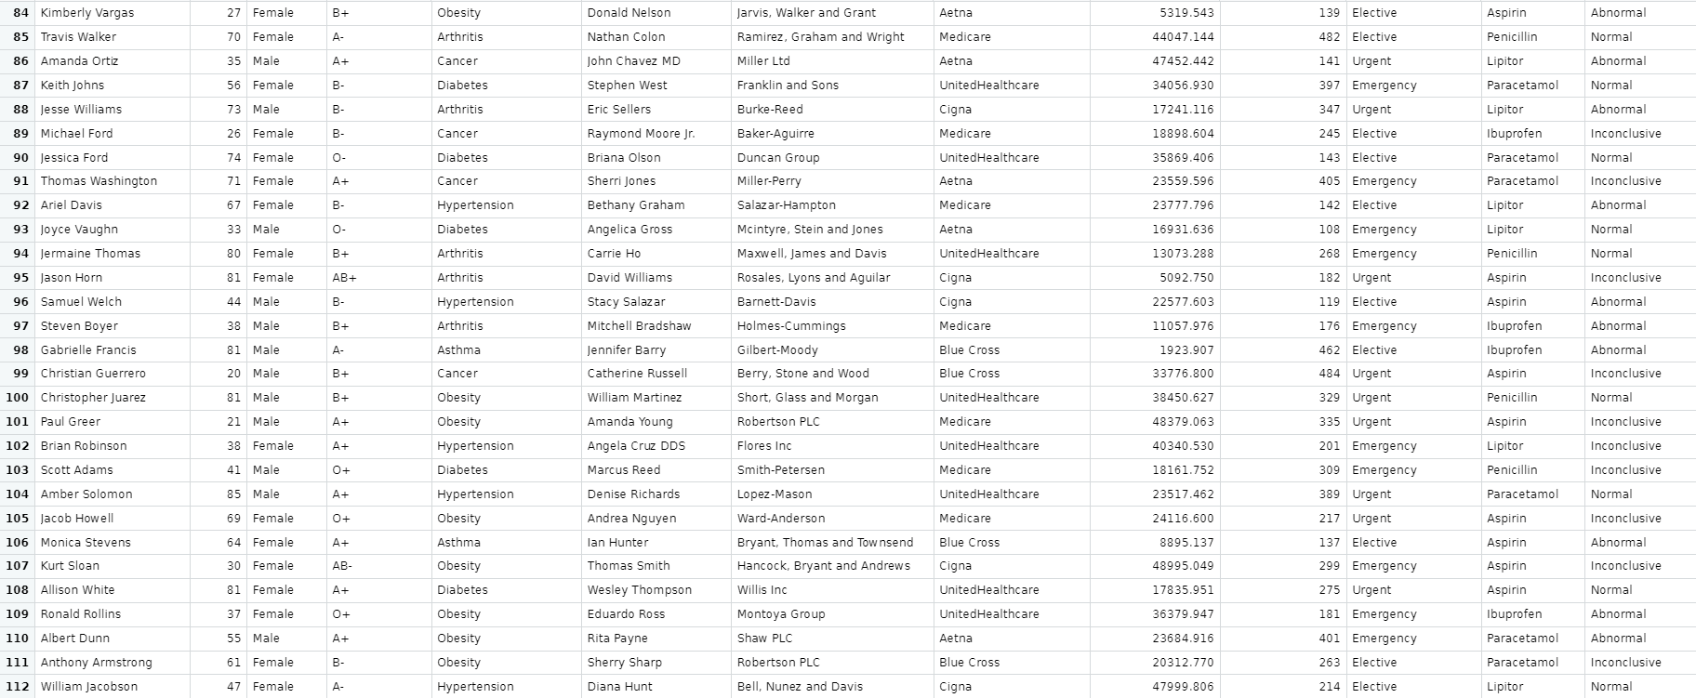

Slide 11
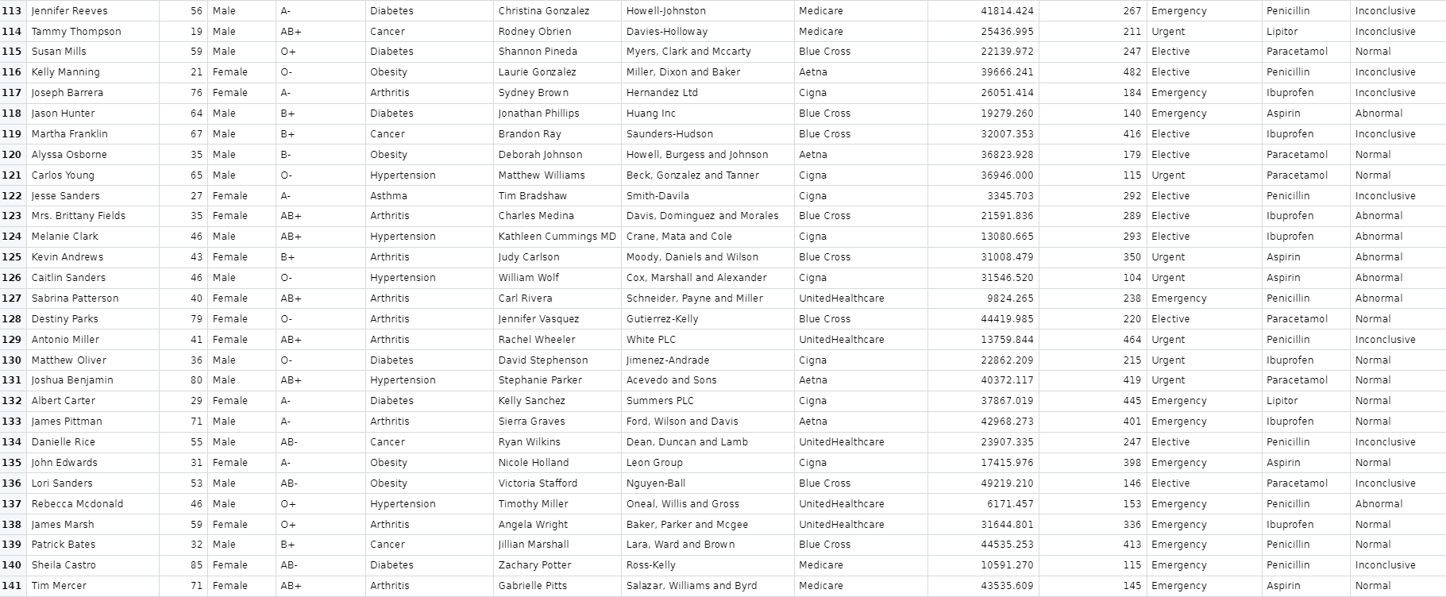

Slide 12
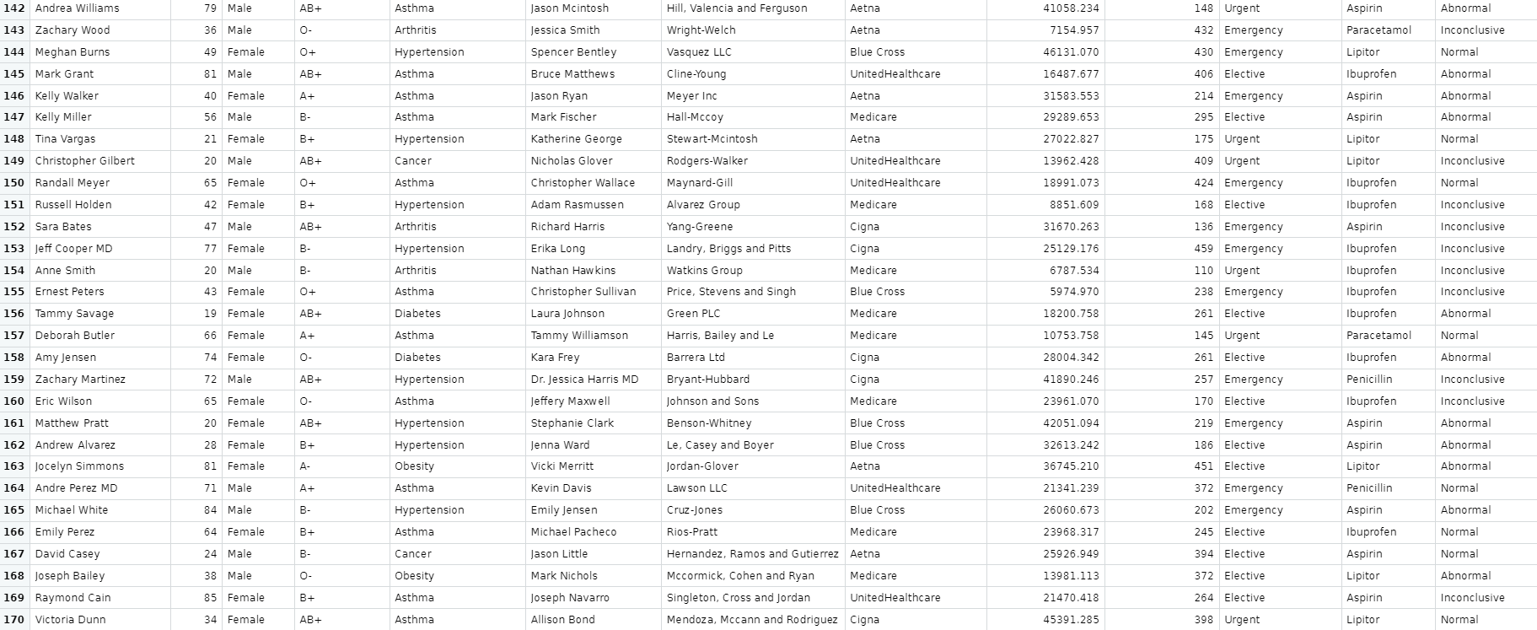

Slide 13
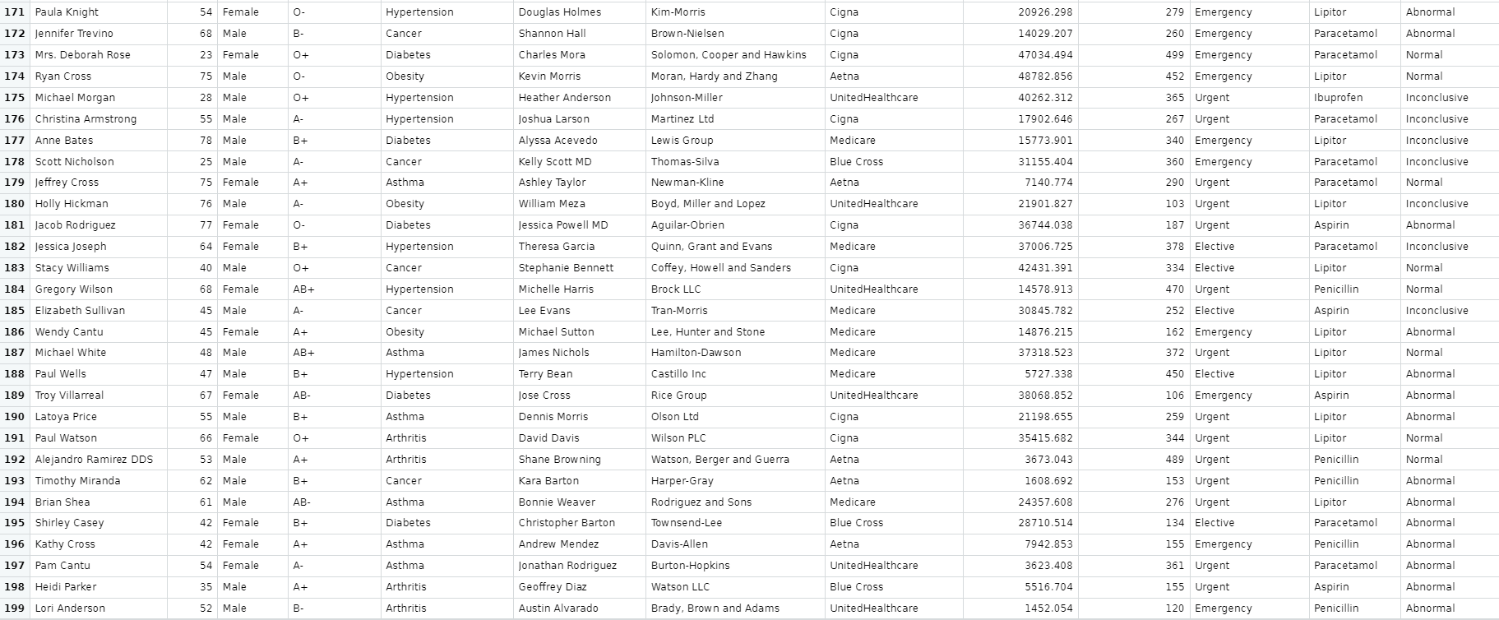

Slide 14
DATASET DESCRIPTION
The dataset consists of the following key attributes:
Name: patients name
Age: patients age
Gender: patients gender
Blood type: patients blood type
Medical condition: the medical condition for which the patient is being treated
Doctor: the doctor assigned to the respective patient
Hospital: the hospital where the patient is admitted
Insurance provider: the patients insurance provider
Billing amount: the total billing amount for the treatment
Room number: the room number where the patient will be staying
Admission type: the type of admission (elective, emergency, urgent)
Medication: the medication prescribed to the patient
Test results: the results of the medical treatments conducted

Slide 15
As the dataset showcases the occurrence of some common medical conditions it becomes essential to have a basic understanding of these.
The different conditions includes diabetes, asthma, obesity, hypertension, cancer and arthritis.
Diabetes:
It is a chronic condition caused due to elevated blood sugar levels. Researchers found studies that talks on various management strategies such as proper medication, lifestyle modifications, role of healthcare providers. Various other sources tell the impact of diabetes based on different age groups.
Asthma:
It is a respiratory based condition which affects a person’s airways causing breathing issues and related difficulties. The most preferred treatments for emergency interventions, as per the latest advancements is the use of inhalers (e.g. Lipitor). This conditions degree of affecting a person can be influenced by age, gender and even blood type.
Obesity:
It is seen as a general cause affecting every 5 people out of 8 at most. This condition is associated with health risks including hypertension and diabetes. Researches also conclude the role of genes might be significant in causing it but its cure and treatments involves the basic or regular prescribed medication to control and prevent the situation from getting out of hands.

Slide 16
Hypertension:
This can also be classified as one of the most common form of condition among all age groups. It is characterized as a result of high blood pressure. It has a correlation with diabetes and obesity. Treatments focuses on medications but majorly on lifestyle improvements that involves getting the patients mental health fit and to make their daily tasks get done, stress and tension free manner.
Cancer:
It is a very serious condition if chronic, but even a slightest hint of cancerous cells can be a fatal sign. It is a disease cased due to uncontrolled cell growth. This may cause a person to lose their hair. Many treatments involving medications like penicillin alongside of chemotherapy seems to get better outcomes. Researches show emerging new therapy forms and personalized medicine for cancer patients.
Arthritis:
This condition results in inflammation of the joints. Various advancements in treatments include medications such as lbuprofen and paracetamol. Such a condition might be seen more among the older age group.

Slide 17
Some more insights on what the dataset includes:
Research in healthcare economics and policy may cover the role of insurance providers and billing practitioners in the systems , such as Medicare or UnitedHealthcare.
Topics like healthcare accessibility, disparities, as well as impact of insurance coverage on the patient outcomes are also highlighted.
Admission types (elective, urgent, emergency) along with medication effectiveness and safety profiles are likely presented.
The importance of accurate and timely test interpretations.
It also showcases various distributions on the bases of age, gender and blood type.

Slide 18
PROPOSED METHODS
PLANNING OF THE TREATMENT:
Recommendation of particular medications, surgeries or therapies.
LIFESTYLE CHANGES:
Modification in a patients daily routine gets essential in preventing health issues.
MEDICATION MANAGEMENT:
Proper guidance with highlighting any potential drug to be included as a strict follow up.
Showcasing the importance of adherence to a prescribed medication.
PROPER MONITORIZATION:
Proper monitoring of a patient and ensuring the follow-up appointments.
24/7 watch on critical patients and emergency management.
EMERGENCY RESPONSE PLANNING:
Provide with a set of instructions always on ethical and legal matters during an emergency call for duty.

Slide 19
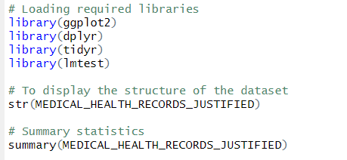
STATISTICAL ANALYSIS
INPUT :

Slide 20
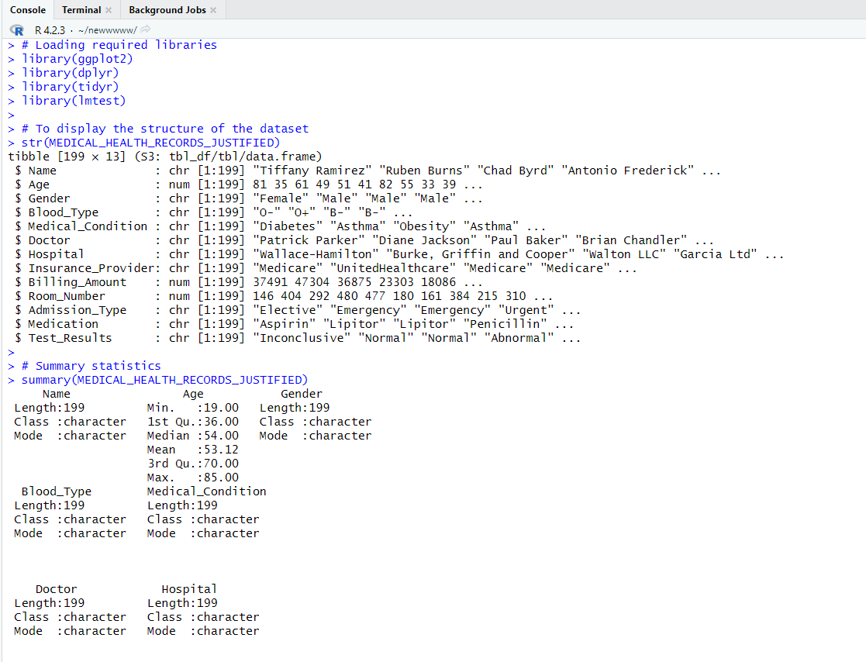
OUTPUT:

Slide 21
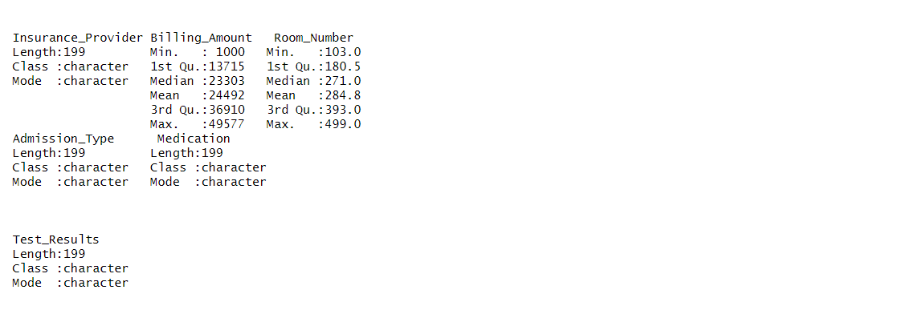

Slide 22
INPUT :

Slide 23
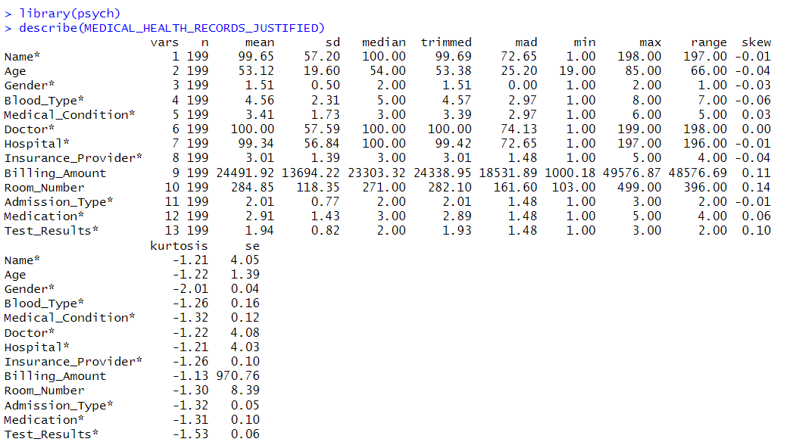
OUTPUT:

Slide 24
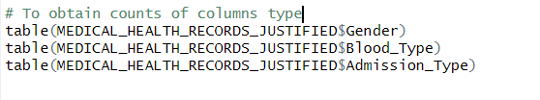

INPUT:

Slide 25
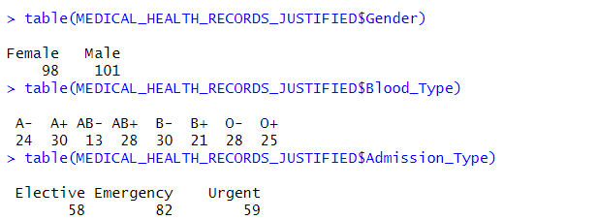
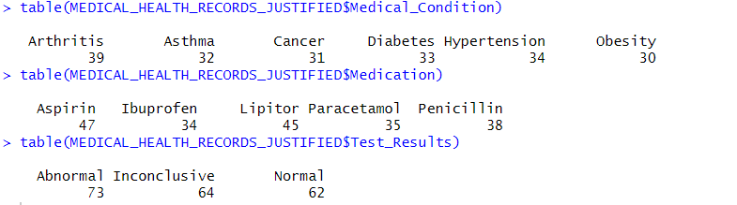
OUTPUT:

Slide 26
STATISTICAL VISUALISATION
INPUT:
plot(MEDICAL_HEALTH_RECORDS_JUSTIFIED)

Slide 27
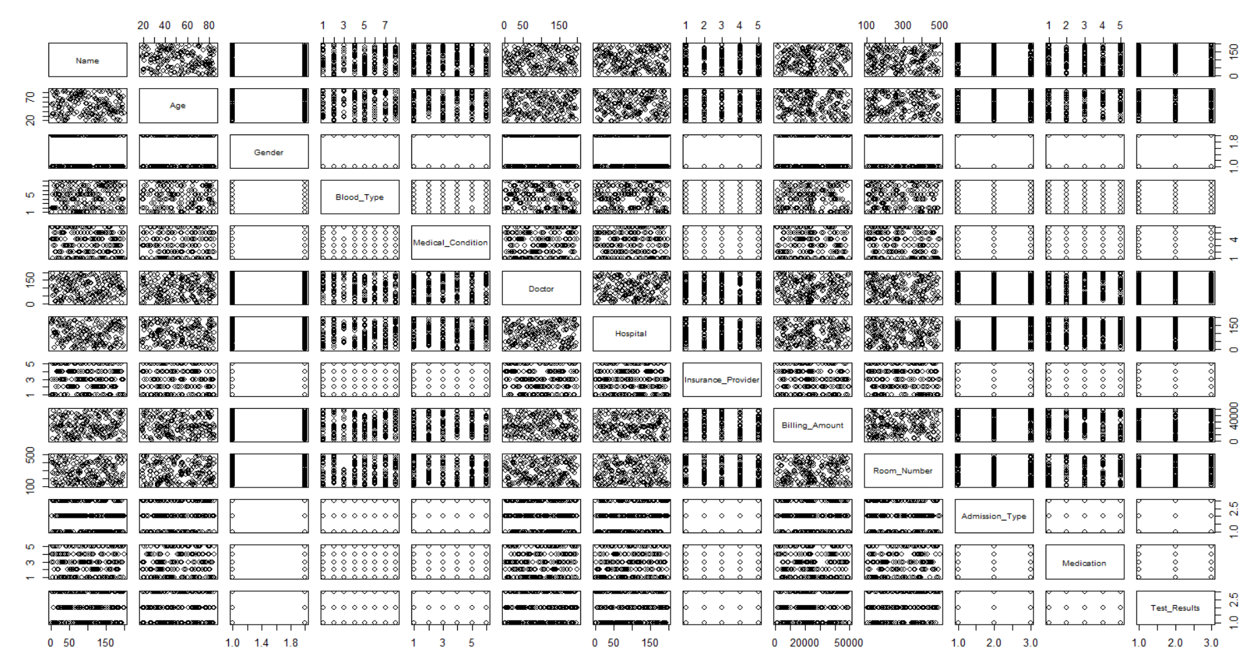
OUTPUT:

Slide 28

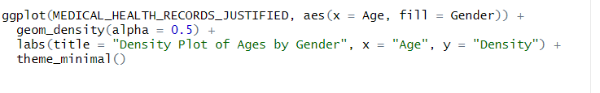
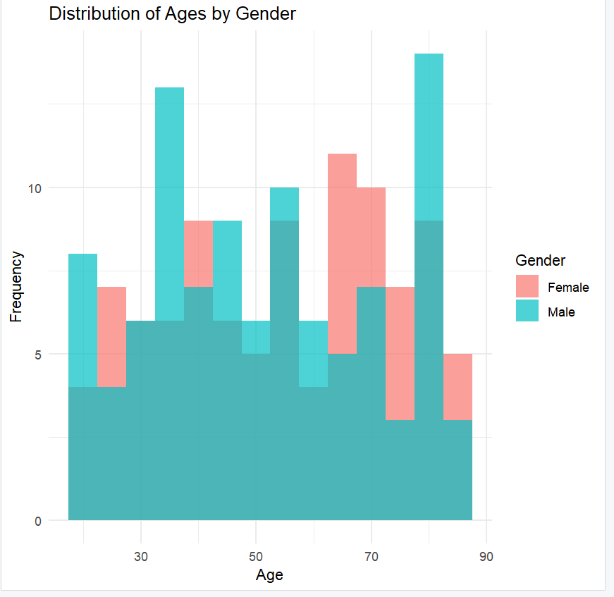
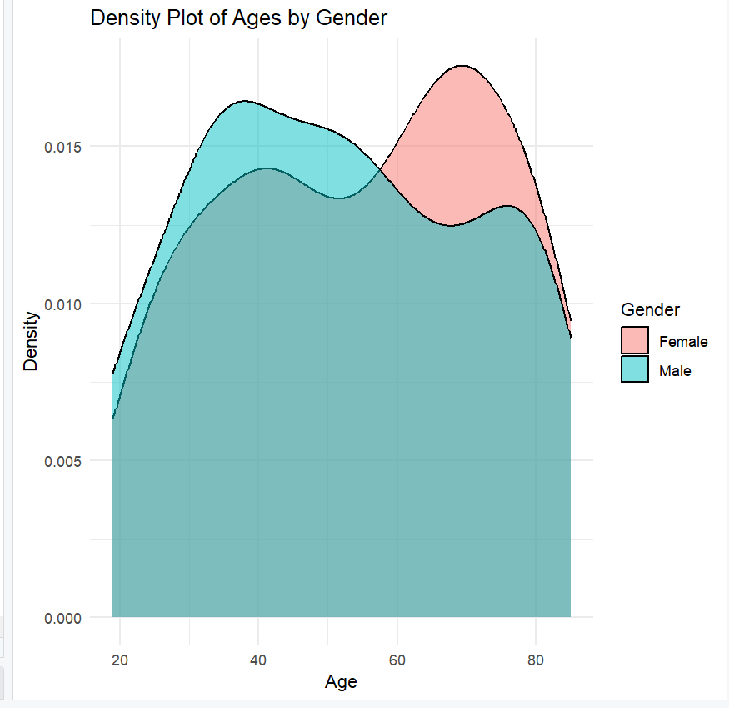
INPUT:
INPUT:
OUTPUT:
OUTPUT:

Slide 29
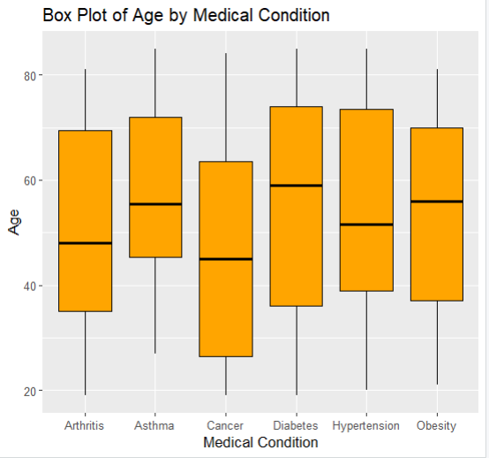
INPUT:
OUTPUT:

Slide 30
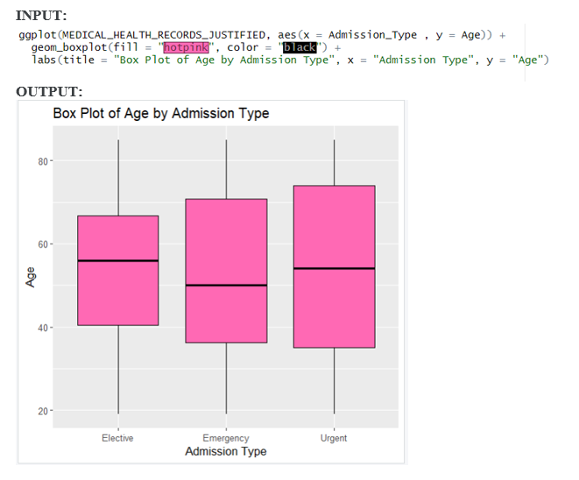

Slide 31
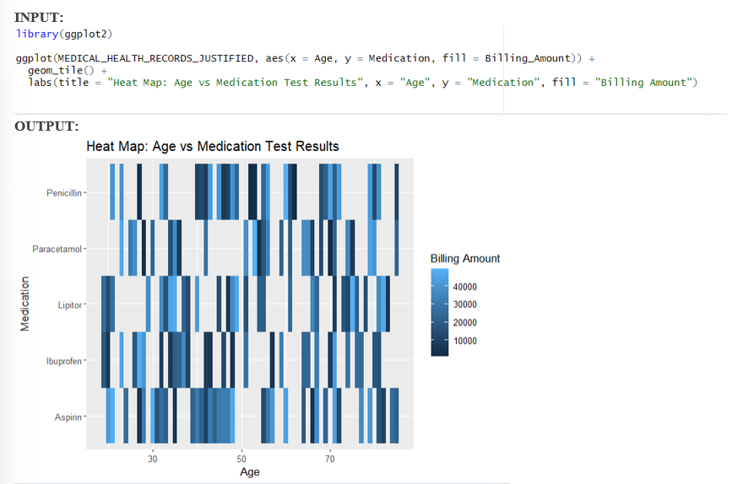

Slide 32
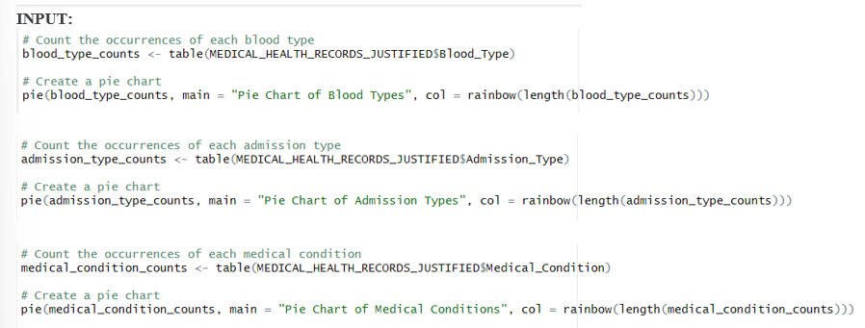

Slide 33
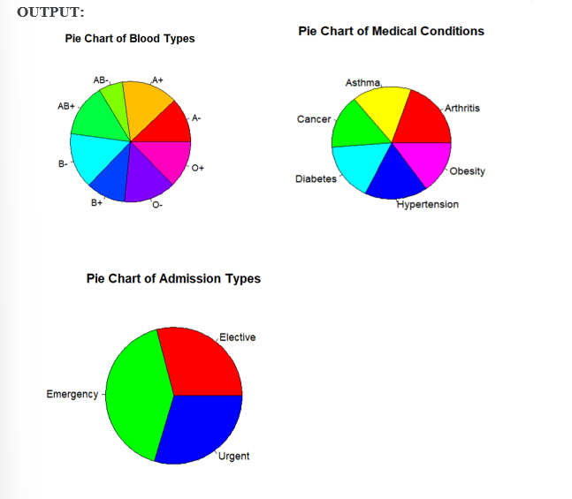

Slide 34
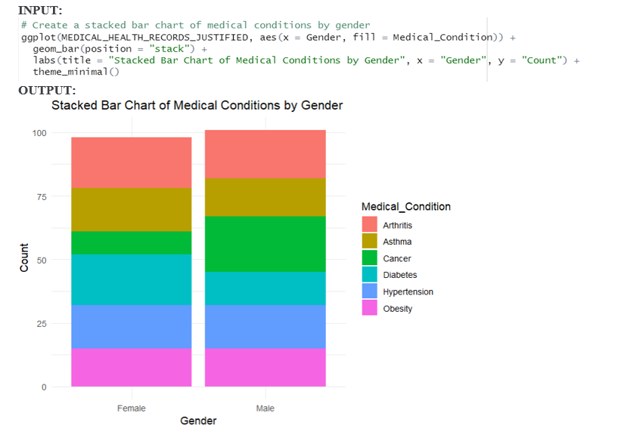

Slide 35
THANK YOU

